Slide 1


Title : SQL PPT
Komal Jain

Slide 2
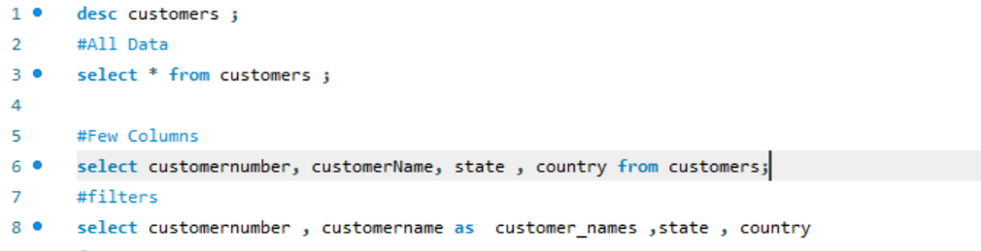
SELECT: This keyword is used to specify the columns that you want to retrieve from the database.
column1, column2, ...: These are the names of the columns you want to retrieve. You can use an asterisk (*) to select all columns.

Slide 3
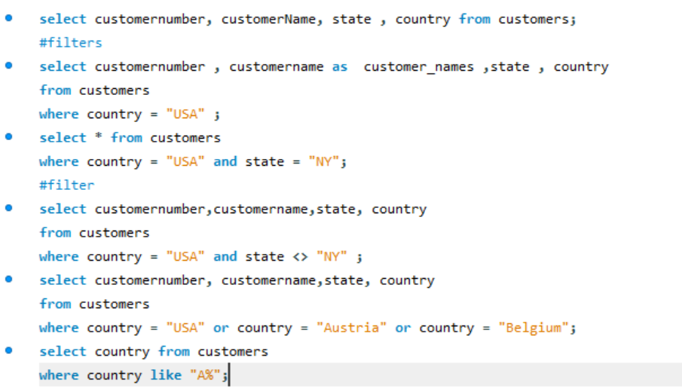
WHERE: This keyword is followed by a condition that specifies which rows to retrieve based on certain criteria.

Slide 4
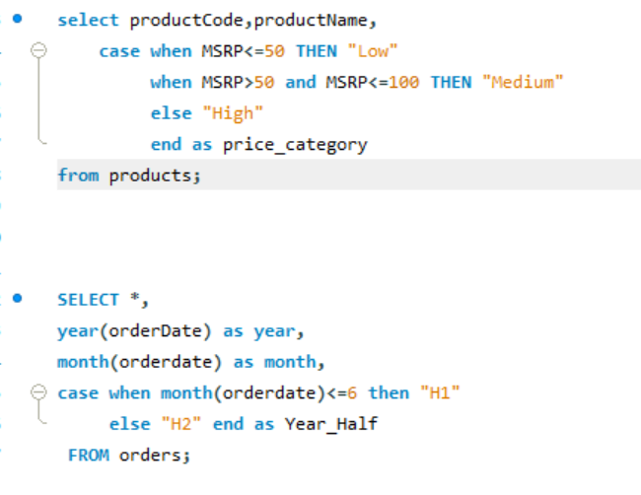
The ‘case when’ statement in SQL is a powerful tool that allows you to perform conditional logic within a query. It is often used to create new columns based on certain conditions or to perform conditional aggregation.

Slide 5
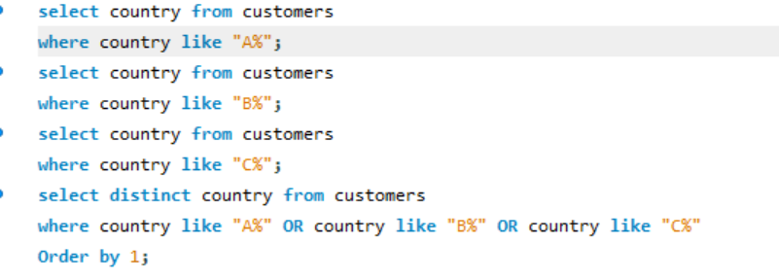
The ‘LIKE’ operator in SQL is used in a ‘WHERE’ clause to search for a specified pattern in a column. It is often used with wildcard characters to perform flexible string matching. Here's a basic syntax for the ‘LIKE’ operator:

Slide 6
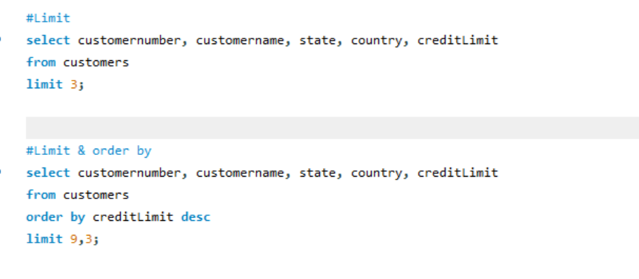
The LIMIT clause in SQL is used to restrict the number of rows returned by a query. It is commonly used in conjunction with the SELECT statement to limit the result set to a specified number of rows. Here's a basic syntax for the LIMIT clause:

Slide 7
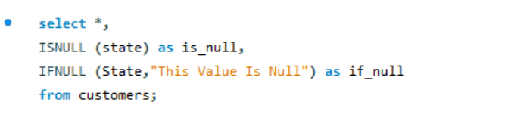
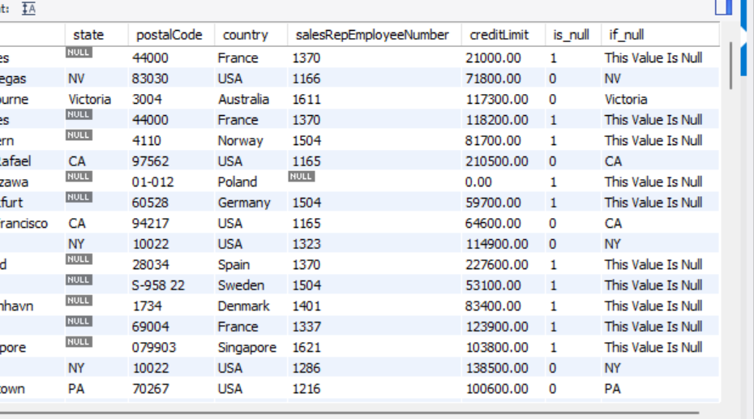
ISNULL and IFNULL are similar functions in SQL, but they are associated with different database systems.
ISNULL:
ISNULL is a function primarily used in Microsoft SQL Server.
It is used to replace NULL values with a specified replacement value.
IFNULL :
IFNULL is a function primarily used in MySQL and SQLite.
It serves a similar purpose to ISNULL by replacing NULL values with a specified replacement value.

Slide 8
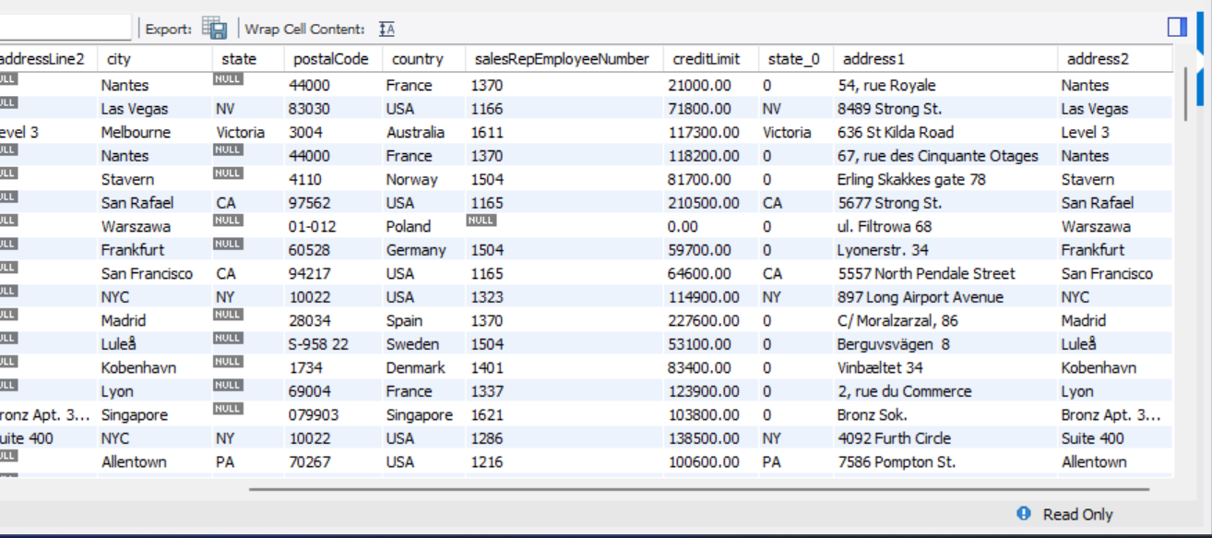
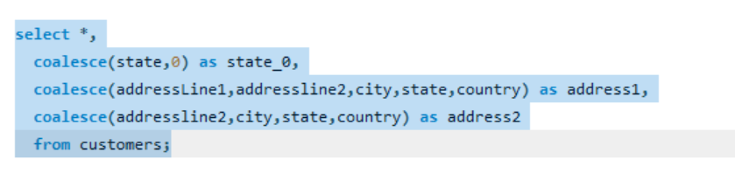
The COALESCE function in SQL is used to return the first non-null expression among its arguments. It is a standard SQL function and is supported by many relational database management systems (RDBMS).

Slide 9
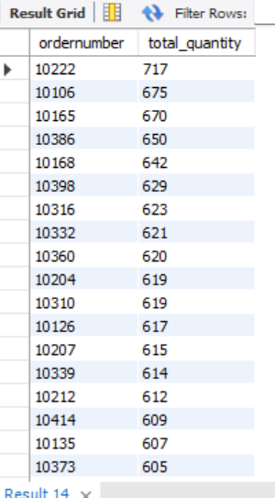
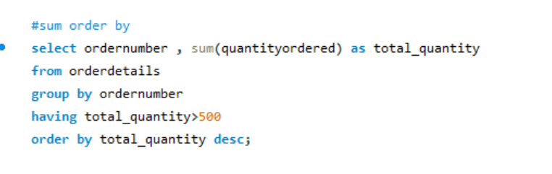
The ORDER BY clause in SQL is used to sort the result set of a query in ascending or descending order based on one or more columns. It is typically used in conjunction with the SELECT statement.

Slide 10
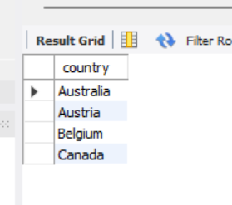
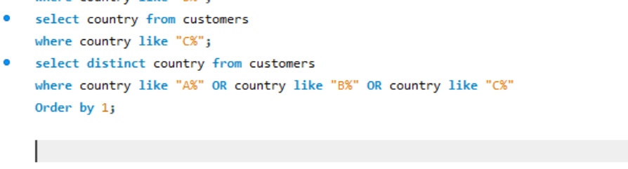
The ORDER BY clause in SQL is used to sort the result set of a query in ascending or descending order based on one or more columns. It is typically used in conjunction with the SELECT statement.

Slide 11
The End

